Slide 1
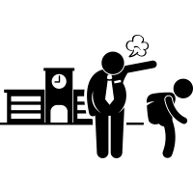
Student Dropout
System
Presented By - Janidi Dihara

Slide 2
WHAT IS THE PROBLEM
If a student who registers for a course in an institution or a student stops the course for any reason, then the institution will face problems. The employee who does it will take a lot of time to confirm it and do the work..

Slide 3
SOLUTION
When a student stops a course, that student is withdrawn from the course. There will be a lot of time and problems for the employee doing it.Through this system the problems will be minimized and the student will be removed and managed.
Student Dropout System

Slide 4
Student Dropout System Interface

Slide 5
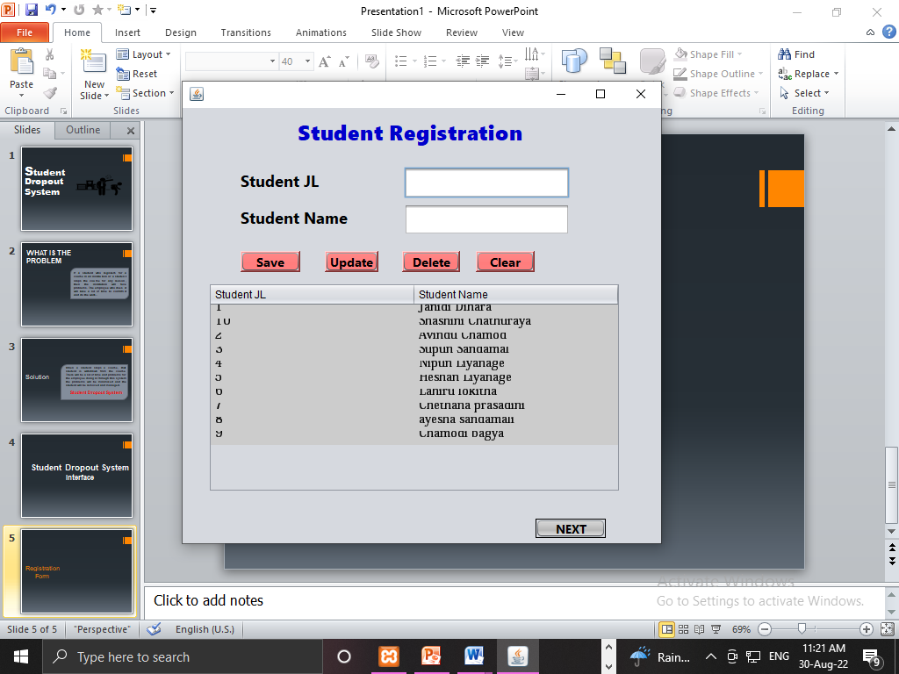
Registration Form

Slide 6
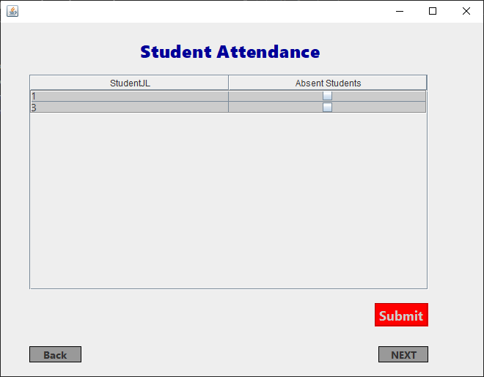
Student Attendance Mark

Slide 7
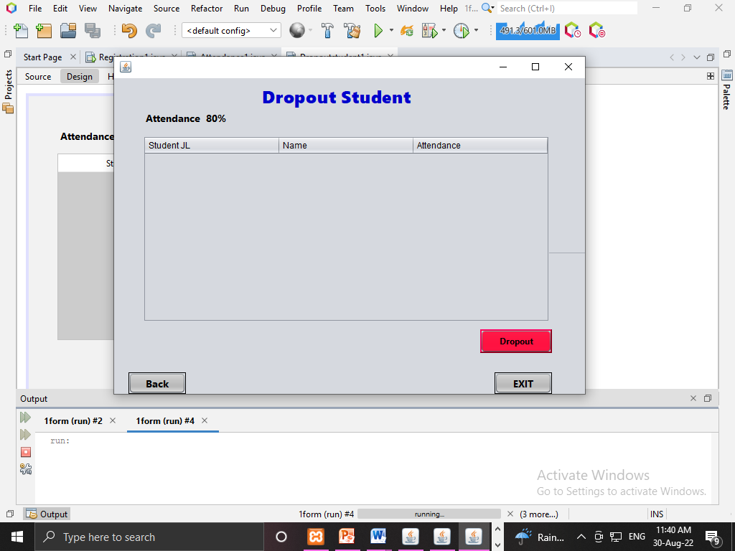
Dropout form

Slide 8
THANK YOU !!!

